Slide 1
Planar UltraRes™ Touch
June 2013
Notes:
1

Slide 2

Planar UltraRes™ 4K Displays
Ultra HD for Professional Applications
84” diagonal, 3840 x 2160 resolution
Outstanding image quality
Optimized for leading resolution-rich commercial applications
Advanced industrial design for function and style
Configuration options tailored to a range of commercial requirements
Advanced energy efficient architecture
Introducing UltraRes™ Touch
Professional 4K, Now Multi-Touch Enabled!

Slide 3
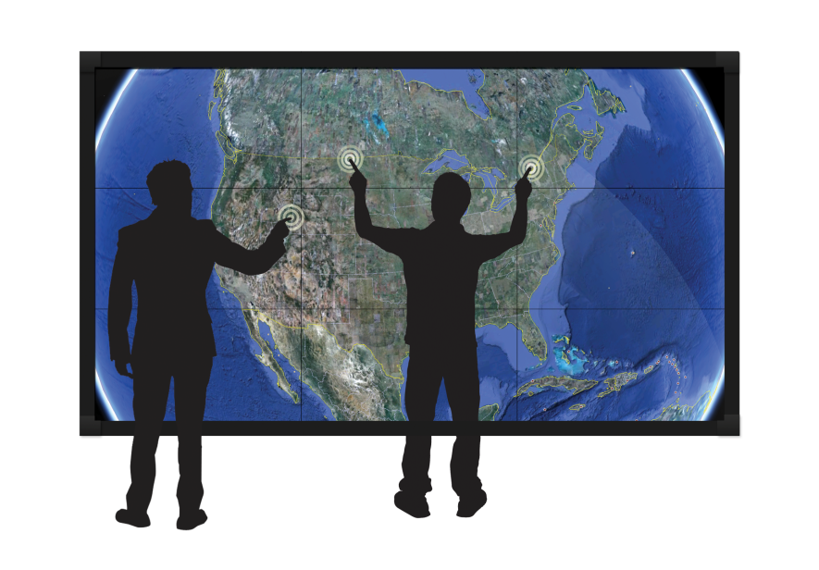


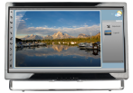
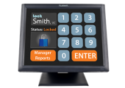
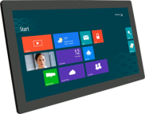
Industry’s Most Comprehensive Touch Line
92” – 300”+
- 6 pt and 32 pt touch
70”- 80”
- 6 pt touch
- Landscape or Portrait
42” – 55”
- 2 to 6 pt touch
15” – 32”
- Desktop, PoS, Kiosk

Slide 4
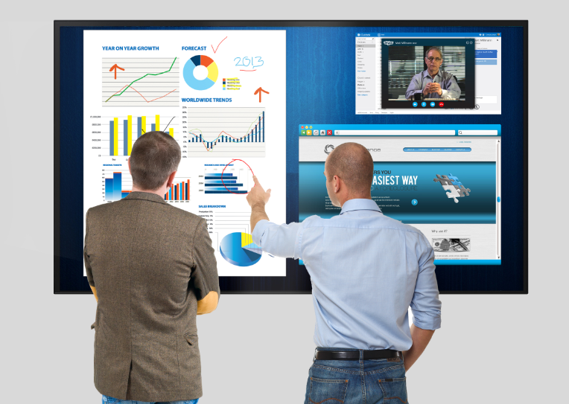
Industry’s Most Comprehensive Touch Line
92” – 300””
- 6 pt and 32 pt touch
70”- 80”
- 6 pt touch
- Landscape or Portrait
42” – 55”
Introducing UltraRes Touch
84” 4K Display
- 6 pt touch
- 2 to 6 pt touch
15” – 32”
- Desktop, PoS, Kiosk

Slide 5

Planar UltraRes™ Touch
Interactive 4K Professional Display
84” diagonal, 3840 x 2160 resolution
Multi-Touch, Multi-User – 6 simultaneous touch points
4K accuracy and full gesture support
Ideal for Board Room: white board, annotation, collaboration and Public Display: way-finding, directory, catalogue, interactive promotions
Includes Planar’s exclusive ERO™ glass surface
Landscape and Portrait capable
Planar factory built and supported

Slide 6

Board Room Installation
Collaboration at it’s best
Ideal board room size with resolution for no-compromises, up-close viewing and interaction
Calibration software and IR multi-touch technology tuned for 4K precision
Supports leading white board and annotation software in Windows, MacOSX and Linux environments. Fully Windows 8 gesture capable
Merges outstanding image quality with natural interactivity providing best in class meeting room productivity
Includes Planar’s low-friction ERO™ glass surface

Slide 7
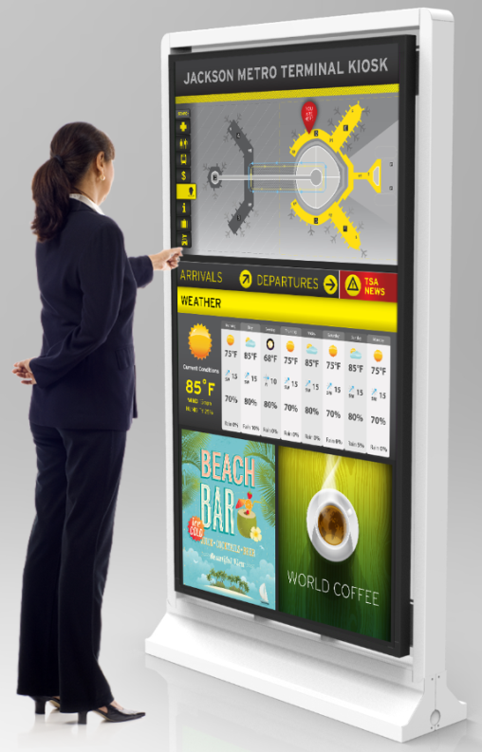
Public Display Installation
Customer engagement at its best
Ideal adult human size with resolution for no-compromises, up-close viewing and interaction
Fine text is legible up close. Images are stunningly life-like at distance and up close
Supports standard gestures used by developers of interactive Windows, Mac (OSX) and Linux applications
Makes customer interaction more engaging, providing the highest quality public display experience
Fully protected with ERO™ optically bonded front surface

Slide 8
UltraRes Touch Specifications
See updated product brochures
Models | UR8450-LX-ERO-B-T UR8450-MX-ERO-B-T UR8450-3D-ERO-B-T
Touch Points | 6 simultaneous
Response Time | 7 – 16 ms
Connectivity Source | USB 2.0
OS Compatibility | Windows 8/7/XP, Mac OS X, Linux
Display Depth with Mount | 3.83" (97.3 mm) ADA compliant
Touch Bezel Width | 1.95” (49.5 mm)
Front Glass | 3 mm, Planar ERO™ optically-bonded glass
Touch Display Weight | 240 lbs (109kg)

Slide 9

Thank you!
Please consider the environment before printing this presentation

