Slide 1
Planar UltraRes™ Professional 4K Displays
September 2013
Notes:
1

Slide 2
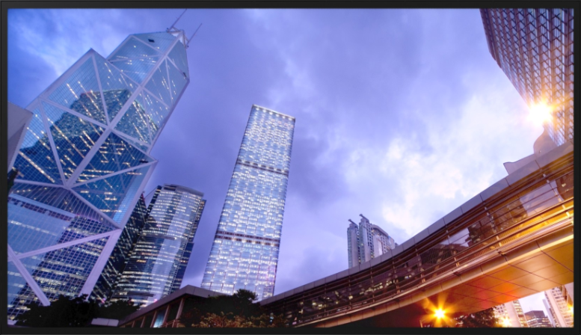
Planar UltraRes™ 4K Displays
Ultra HD for Professional Applications
84” diagonal, 3840 x 2160 resolution
Outstanding image quality
Optimized for leading resolution-rich commercial applications
Advanced industrial design for function and style
Configuration options tailored to a range of commercial requirements
Advanced energy efficient architecture

Slide 3
Planar UltraRes™ 4K Displays
Ultra HD for Professional Applications
84” diagonal, 3840 x 2160 resolution
Outstanding image quality
Optimized for leading resolution-rich commercial applications
Advanced industrial design for function and style
Configuration options tailored to a range of commercial requirements
Advanced energy efficient architecture

Slide 4
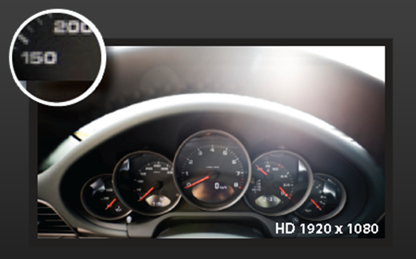
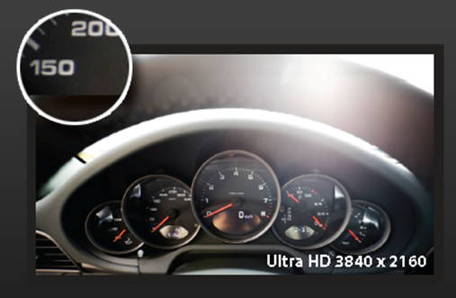
Outstanding Image Quality
The obvious stuff
80” Full HD Display
84” UltraRes™
4x the pixel density

Slide 5
Outstanding Image Quality
The obvious stuff
2x2 46” Full HD SNB displays
84” UltraRes™
6.7 ft x 3.8 ft
6.3 ft x 3.6 ft
Similar size, Same resolution, no bezels

Slide 6
Outstanding Image Quality
The less obvious stuff
120Hz response rate
True 10bit color depth support
Configurable local dimming
Support for 4K @ 60Hz
High brightness option
Continuous stereo passive glasses 3D option
Built-in quad view
High quality up-scaling and down-scaling
= Planar UltraRes™

Slide 7
Planar UltraRes™ 4K Displays
Ultra HD for Professional Applications
84” diagonal, 3840 x 2160 resolution
Outstanding image quality
Optimized for leading resolution-rich commercial applications
Advanced industrial design for function and style
Configuration options tailored to a range of commercial requirements
Advanced energy efficient architecture

Slide 8
Resolution-rich Commercial Applications
Industrial
Geospatial – satellite surveillance, mapping
Oil/gas – exploration, production management
Process control – power distribution management
CAD – aerospace, engineering, design, architecture
Visualization / Simulation
Medical imaging
Digital post-production proofing and monitoring (broadcast)
Scientific – university and commercial use
Control Room – side-by-side with windowing
Conference Room / Decision Room – business information and analysis
Branding
Digital Signage / Branding – Retail, Movie Poster..

Slide 9
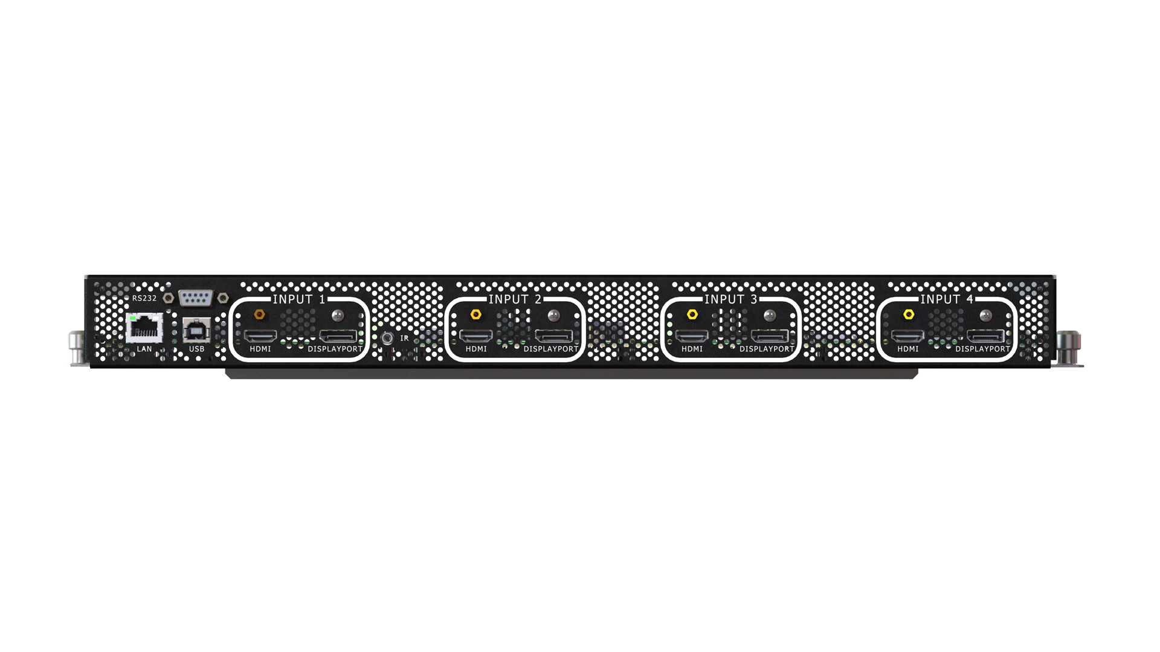
UltraRes™ Electronics
Designed for commercial applications
4 x HDMI 1.4a
4 x DisplayPort 1.1
LAN, USB and Serial
Multi-head input: Up to 4K @ 60Hz
Single input: Up to 4K @ 30Hz

Slide 10
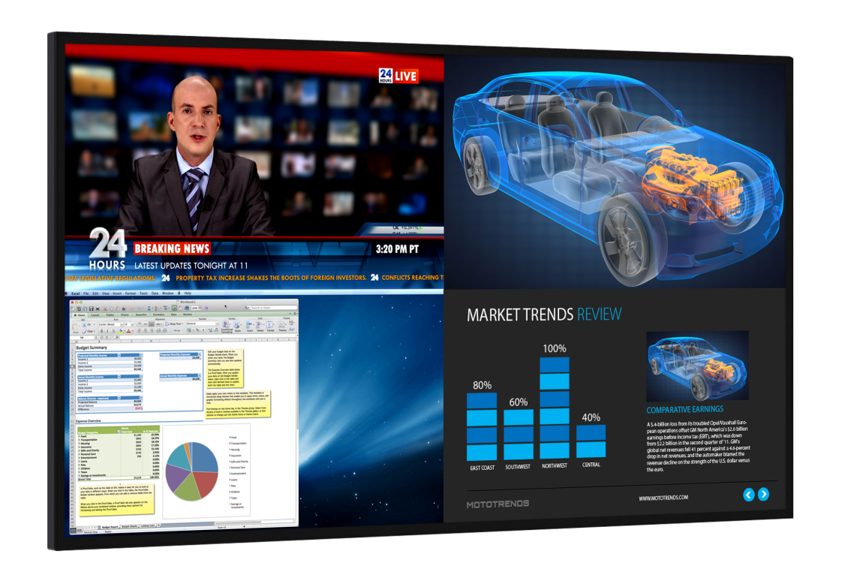
UltraRes MediaPlex Software
Built-in Quad View and Scaling
Rotate between 8 directly connected sources in Quad View mode
Downscale 4k or Upscale sub-1080 into a Full HD Quadrant
Upscale any Quadrant into full screen 4K mode
Provides an efficient use of the size and resolution of UltraRes with no external processors

Slide 11
Planar UltraRes™ 4K Displays
Ultra HD for Professional Applications
84” diagonal, 3840 x 2160 resolution
Outstanding image quality
Optimized for leading resolution-rich commercial applications
Advanced industrial design for function and style
Configuration options tailored to a range of commercial requirements
Advanced energy efficient architecture

Slide 12
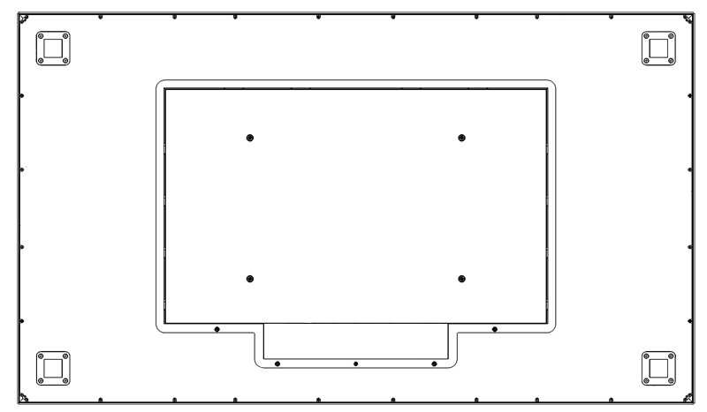
Industrial Design Matters
Slim bezel
Logo free
Place-able IR sensor
Metal bezel
VESA or Planar Profile™ mounting
Front service access. Lockable.
Field serviceable
Easy connectivity access
Power failover
Fan-less

Slide 13
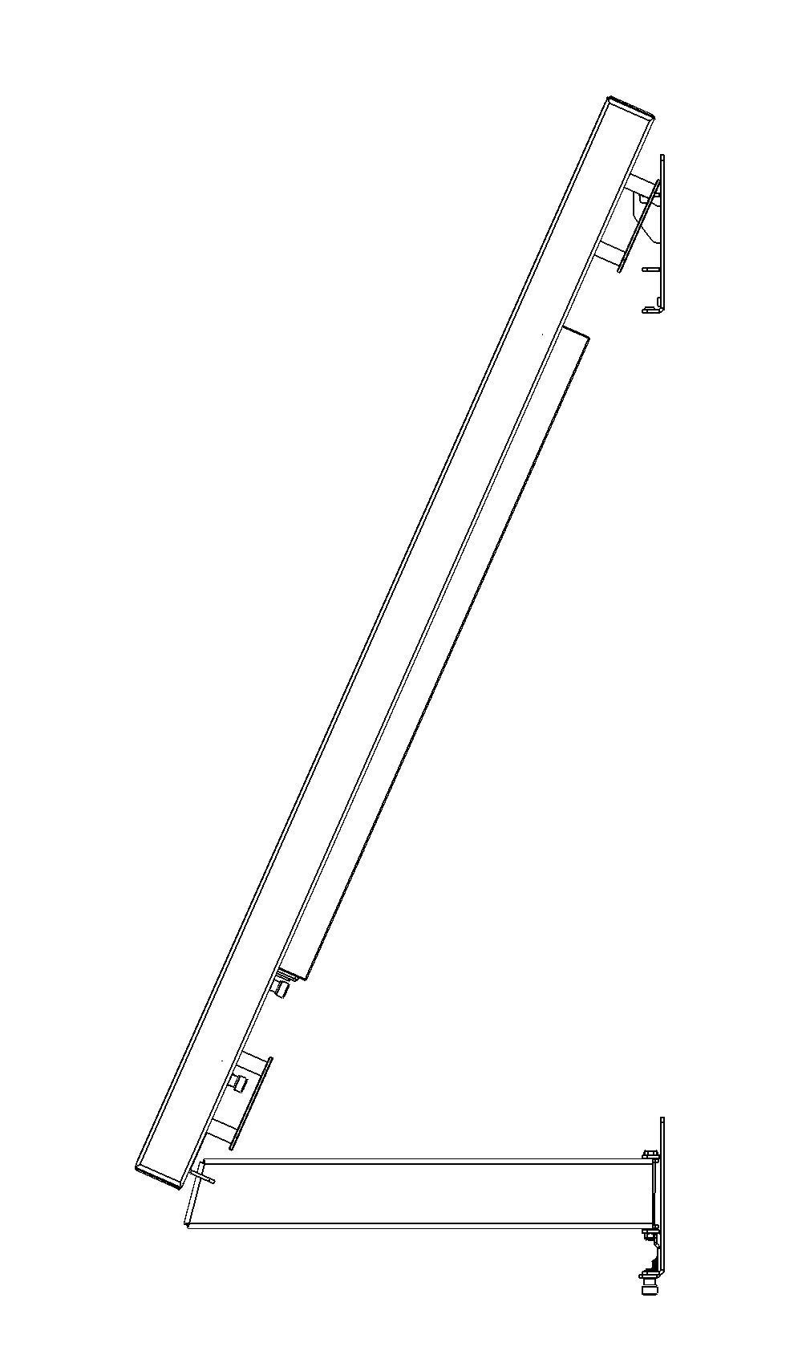
Planar Profile™ Mount
ceiling
Slim mount with service access mode
Mounts ~3 inches from wall – ADA Compliant
Locks in place
Pivots open, kick-stand holds
Access to cables
Access to removable service panel
wall

Slide 14
Planar UltraRes™ 4K Displays
Ultra HD for Professional Applications
84” diagonal, 3840 x 2160 resolution
Outstanding image quality
Optimized for leading resolution-rich commercial applications
Advanced industrial design for function and style
Configuration options tailored to a range of commercial requirements
Advanced energy efficient architecture

Slide 15
Planar UltraRes™ Versions
 | UR8450-LX | UR8450-MX | UR8450-3D
Brightness | 350 nits | 500 nits | 420 nits
3D Support | No | No | Yes
Orientation | Landscape | Landscape / Portrait | Landscape
Front Surface | Low-reflectance / matte | Low-reflectance / matte | Anti-reflectance / gloss
Touch versions available for all UR8450 models.

Slide 16
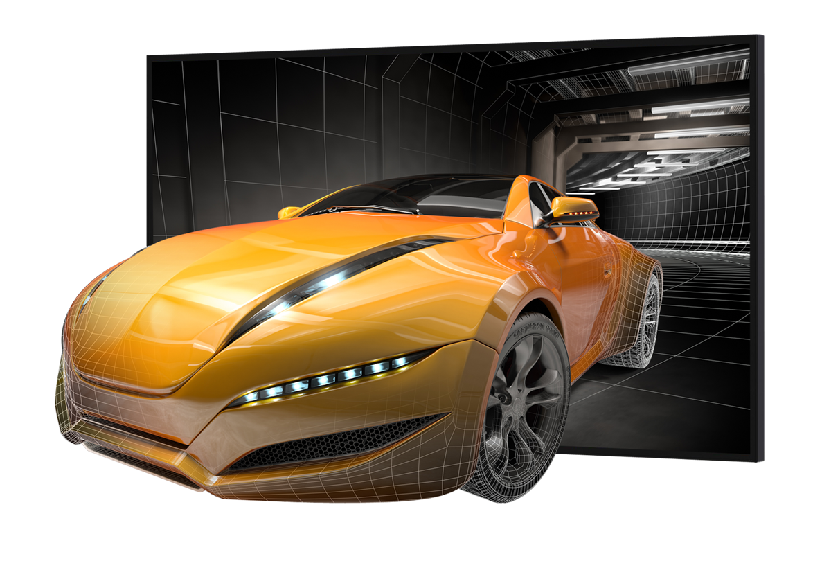
UltraRes 3D: Easier and Better
Flicker-free, full resolution
Continuous 1080 to each eye
Low cost, reliable passive glasses
Effortlessly move between 2D and 3D content with today’s latest generation graphics cards
Notes:
Uses FPR (Film Pattern Retarder) technology – LG’s. No flicker or cross-talk. Horizontal interleave

Slide 17
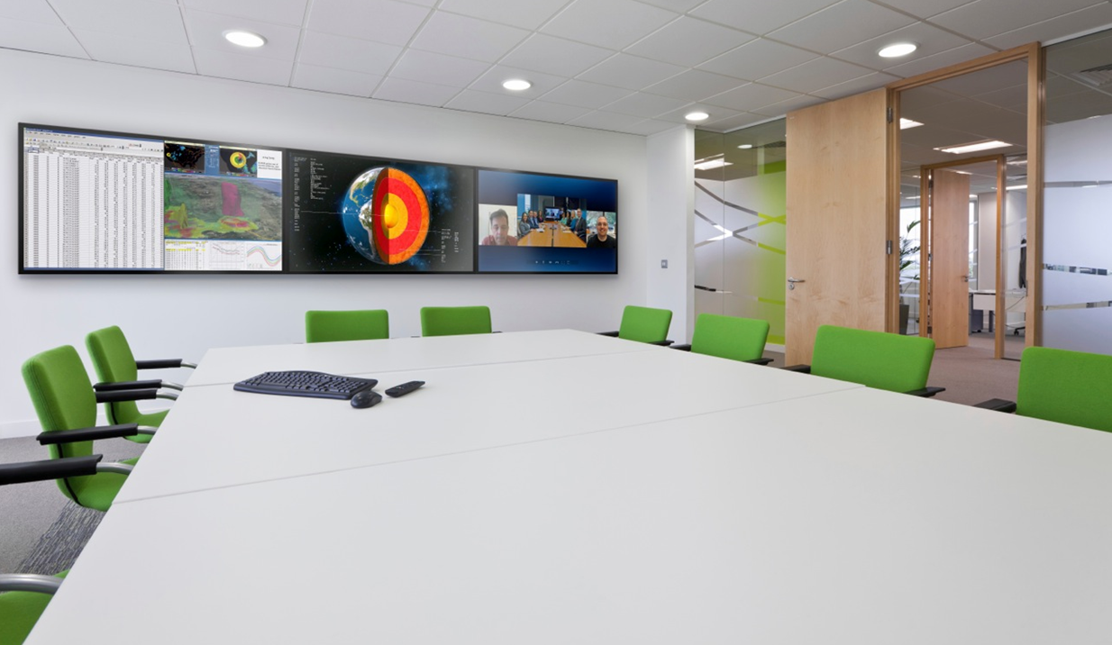
Wall Configurations
Horizontal wall configurations with Planar Profile™ tiling kit
Utilizes Planar Profile™ mounting system
Tiling Kit assists in flush side-by-side alignment
Supports range of horizontal wall sizes
Notes:
19 feet wide (3 wide)

Slide 18
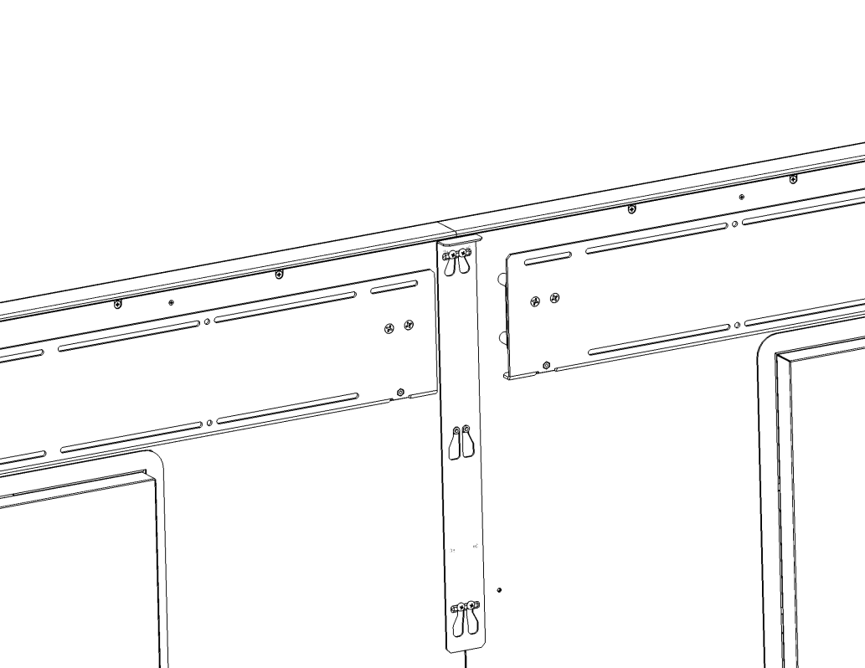
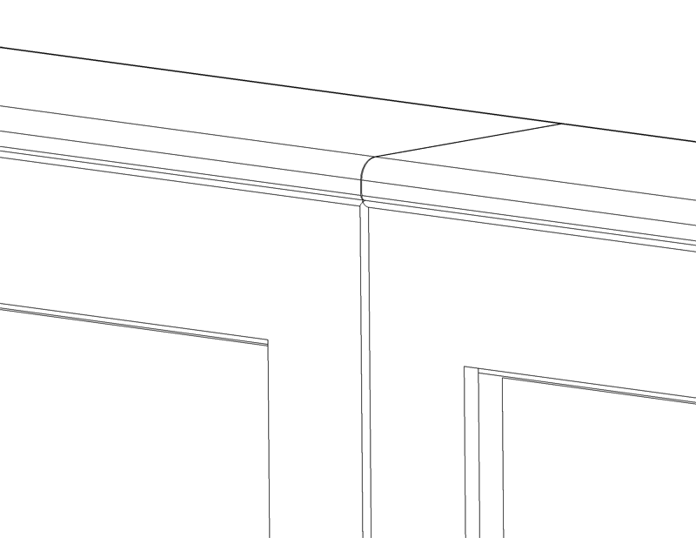
Planar Profile™ Tiling Kit
Eliminates side extrusions
Provides flush top and bottom extrusions
Template assists with mount alignment
Tiling slide tightens and aligns adjoining displays

Slide 19
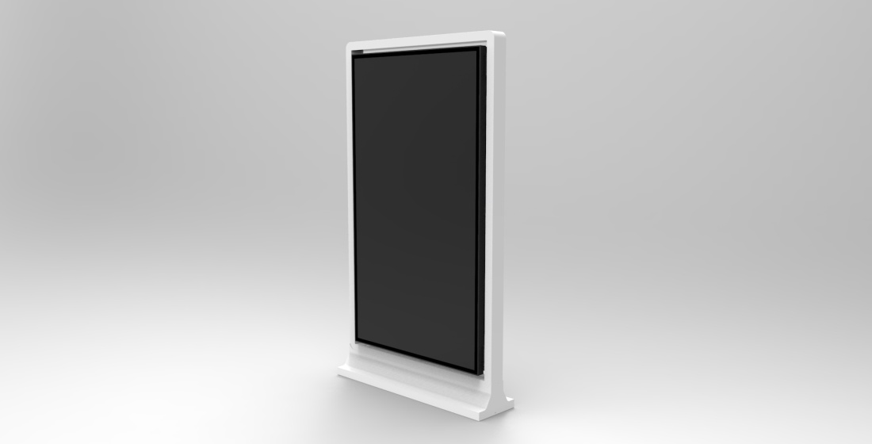
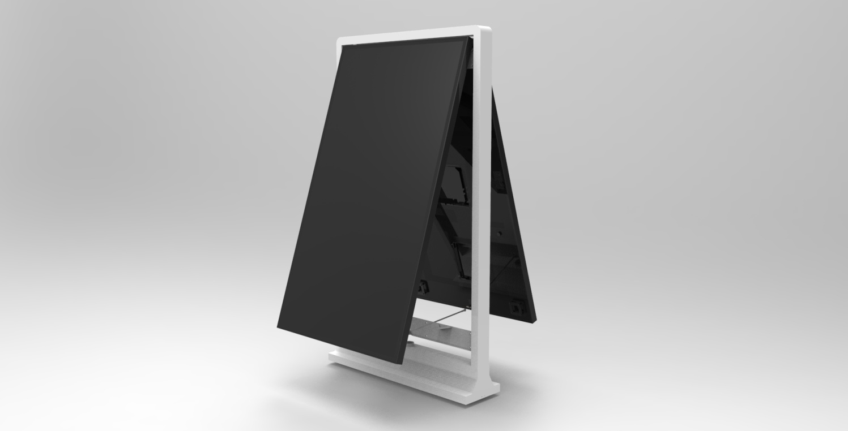
UltraRes Free-standing Pedestal
Single and double-sided
Service access mode
Supports UR8450-MX

Slide 20
Planar UltraRes™ 4K Displays
Ultra HD for Professional Applications
84” diagonal, 3840 x 2160 resolution
Outstanding image quality
Optimized for leading resolution-rich commercial applications
Advanced industrial design for function and style
Configuration options tailored to a range of commercial requirements
Advanced energy efficient architecture

Slide 21
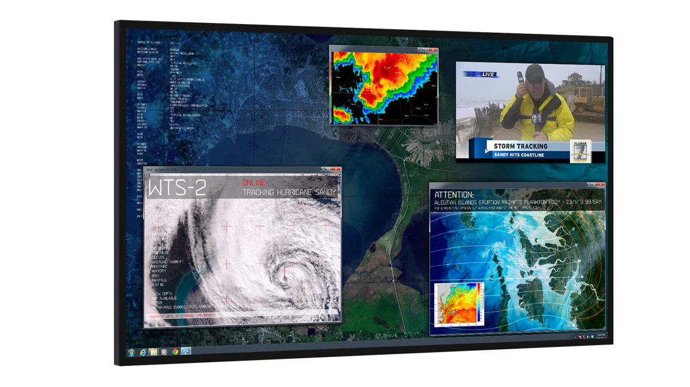
Big Display, Walks Softly
Breakthrough Large-Format Energy Efficiency
Lower power design using edge-Lit LED and passive cooling
<0.5Watt standby power usage
Auto-off signal detection
No lead or mercury
Ultra-quiet fan-less operation

Slide 22
13 Reasons Professionals Need UltraRes, Not a TV
Electronics that support professional applications.
4K @ 60Hz, Multi-output graphics card support – nVidia, AMD, Windowing processor support.
10bit color – true end-to-end implementation
Slimmest mounting profile and ADA compliant
In-place service access mode (hinge and kickstand)
Fail-over power redundancy
Quiet operation – Fanless
Full serial command set, LAN and RS232, SNMP support
Built-in Quad View to view multiple sources (UltraRes MediaPlex)
Horizontal tiling kit
Portrait orientation support (signage applications)
3 panel options to meet specific needs
Multi-Touch available for all 3 versions
Warranty and support

Slide 23
Thank you!

