Slide 1
Planar UltraRes™ Professional 4K Displays
February 2013
Notes:
1

Slide 2
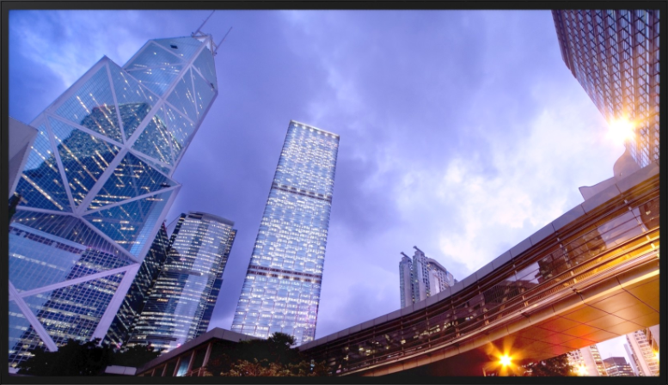
Planar UltraRes™ 4K Displays
Ultra HD for Professional Applications
84” diagonal, 3840 x 2160 resolution
Outstanding image quality
Optimized for leading resolution-rich commercial applications
Advanced industrial design for function and style
Configuration options tailored to a range of commercial requirements
Advanced energy efficient architecture

Slide 3
Planar UltraRes™ 4K Displays
Ultra HD for Professional Applications
84” diagonal, 3840 x 2160 resolution
Outstanding image quality
Optimized for leading resolution-rich commercial applications
Advanced industrial design for function and style
Configuration options tailored to a range of commercial requirements
Advanced energy efficient architecture

Slide 4
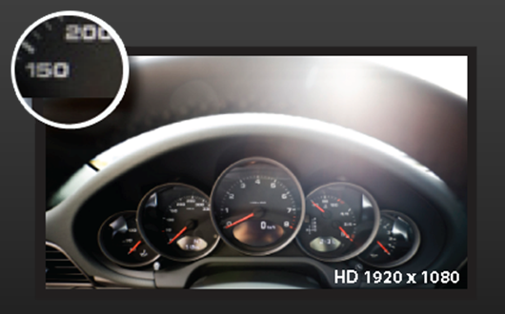
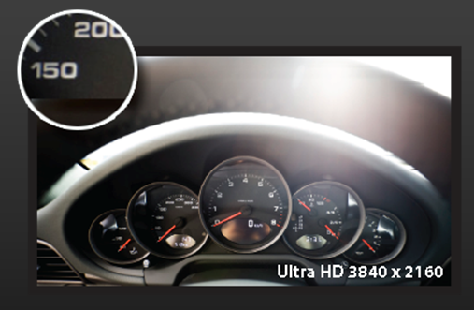
Outstanding Image Quality
The obvious stuff
80” Full HD Display
84” UltraRes™
4x the pixel density

Slide 5

Outstanding Image Quality
The obvious stuff
2x2 46” Full HD SNB displays
84” UltraRes™
6.7 ft x 3.7 ft
6.3 ft x 3.7 ft
Similar size, Same resolution, no bezels
Notes:
LX46HD 2x2 w/cables. .$19.5K List vs. $23K and $26K list UR w/mount
MX46HD 2x2 w/cables . $25K list

Slide 6
Outstanding Image Quality
The less obvious stuff
120Hz response rate
True 10bit color depth support
Configurable local dimming
Support for 4K @ 60Hz
High brightness option
Continuous stereo passive glasses 3D option
= Planar UltraRes™

Slide 7
Planar UltraRes™ 4K Displays
Ultra HD for Professional Applications
84” diagonal, 3840 x 2160 resolution
Outstanding image quality
Optimized for leading resolution-rich commercial applications
Advanced industrial design for function and style
Configuration options tailored to a range of commercial requirements
Advanced energy efficient architecture

Slide 8
Resolution-rich Commercial Applications
Industrial
  Geospatial – satellite surveillance, mapping
  Oil/gas – exploration, production management
  Process control – power distribution management
  CAD – aerospace, engineering, design, architecture
  Visualization / Simulation
  Medical imaging
  Digital post-production proofing and monitoring (broadcast)
  Scientific – university and commercial use
  Control Room – side-by-side with windowing
  Conference Room / Decision Room – business information and analysis
Branding
  Digital Signage / Branding – Retail, Movie Poster..

Slide 9





Driving These Applications
Capture
Play
Connect
Display

Slide 10
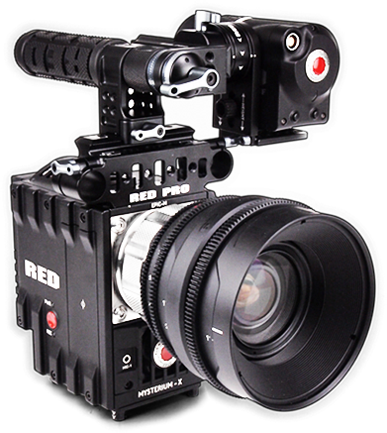
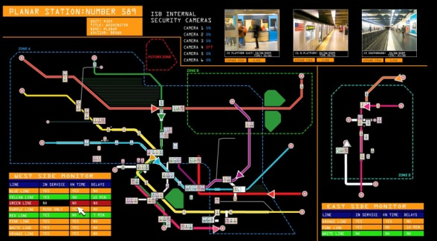
4K Content
Two Sources, Two Sets of Requirements
Video
Visual Applications
Notes:
RED Digital Cinema - EPIC
Canon EOS c500

Slide 11
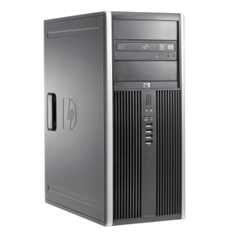
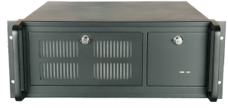
Driving Visual Industrial Applications
Capture
Play
Connect
Display
PC Server
Processor
Typically synchronized multi-head output
Up to 60fps refresh rate
Application-driven content vs. video
Multiple sources

Slide 12
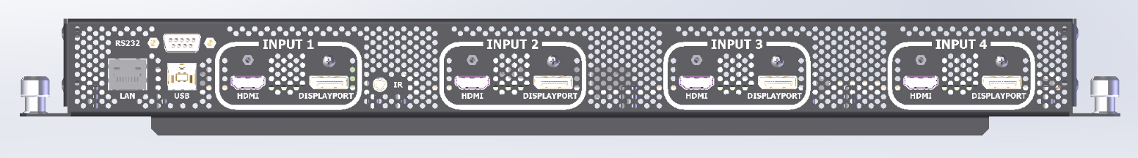
UltraRes™ Electronics
Designed for commercial applications
4 x HDMI 1.4a
4 x DisplayPort 1.1
LAN, USB and Serial
Multi-head input: Up to 4K @ 60Hz
Single input: Up to 4K @ 30Hz

Slide 13
Planar UltraRes™ 4K Displays
Ultra HD for Professional Applications
84” diagonal, 3840 x 2160 resolution
Outstanding image quality
Optimized for leading resolution-rich commercial applications
Advanced industrial design for function and style
Configuration options tailored to a range of commercial requirements
Advanced energy efficient architecture

Slide 14
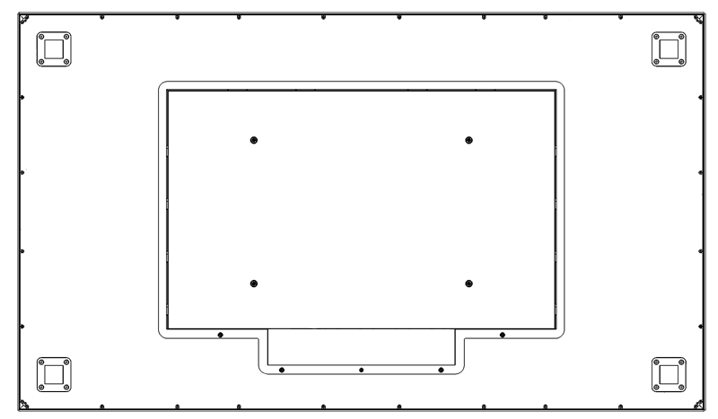
Industrial Design Matters
Slim bezel
Logo free
Place-able IR sensor
Metal bezel
VESA or Planar Profile™ mounting
Front service access. Lockable.
Field serviceable
Easy connectivity access
Power failover
Fan-less

Slide 15
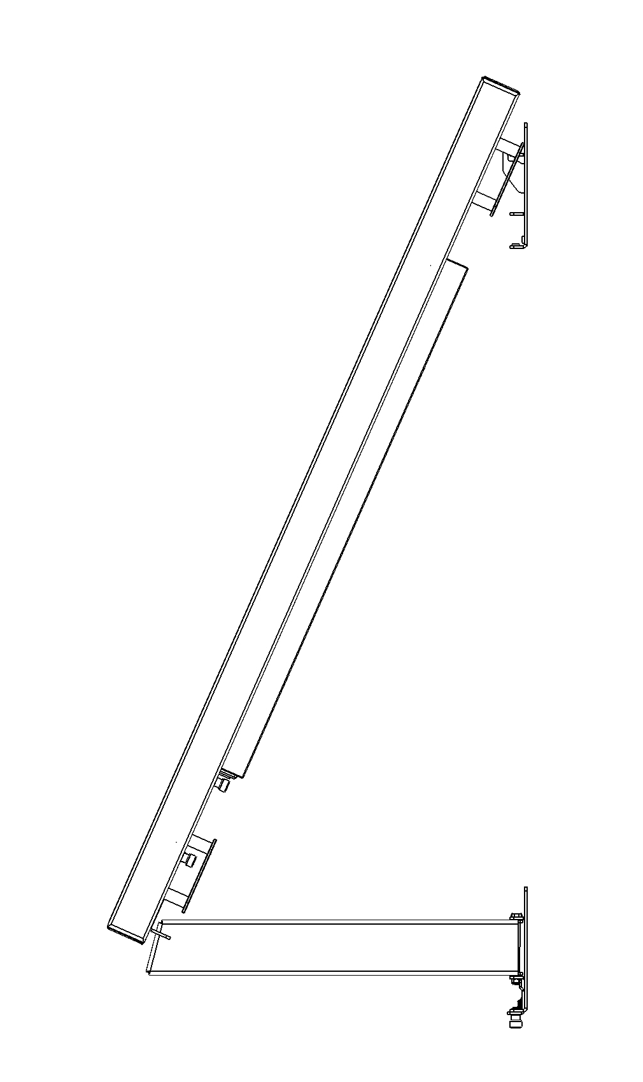
Planar Profile™ Mount
ceiling
Slim mount with service access mode
Mounts ~3 inches from wall – ADA Compliant
Locks in place
Pivots open, kick-stand holds
Access to cables
Access to removable service panel
wall

Slide 16
Planar UltraRes™ 4K Displays
Ultra HD for Professional Applications
84” diagonal, 3840 x 2160 resolution
Outstanding image quality
Optimized for leading resolution-rich commercial applications
Advanced industrial design for function and style
Configuration options tailored to a range of commercial requirements
Advanced energy efficient architecture

Slide 17
Planar UltraRes™ Versions
 | UR8450-LX | UR8450-MX | UR8450-3D
Brightness | 350 nits | 500 nits | 420 nits
3D Support | No | No | Yes
Orientation | Landscape | Landscape / Portrait | Landscape
Front Surface | Low-reflectance / matte | Low-reflectance / matte | Anti-reflectance / gloss

Slide 18
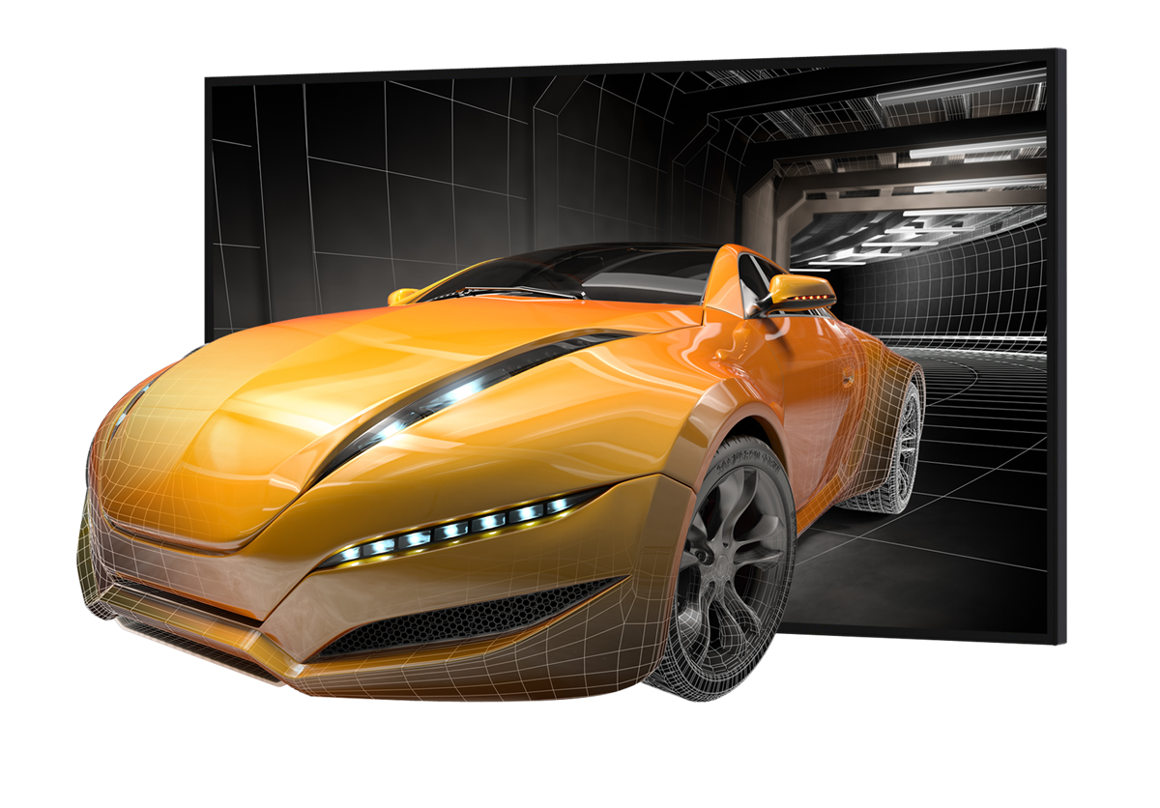
UltraRes 3D: Easier and Better
Flicker-free, full resolution
Continuous 1080 to each eye
Low cost, reliable passive glasses
Effortlessly move between 2D and 3D content with today’s latest generation graphics cards
Notes:
Uses FPR (Film Pattern Retarder) technology – LG’s. No flicker or cross-talk. Horizontal interleave

Slide 19
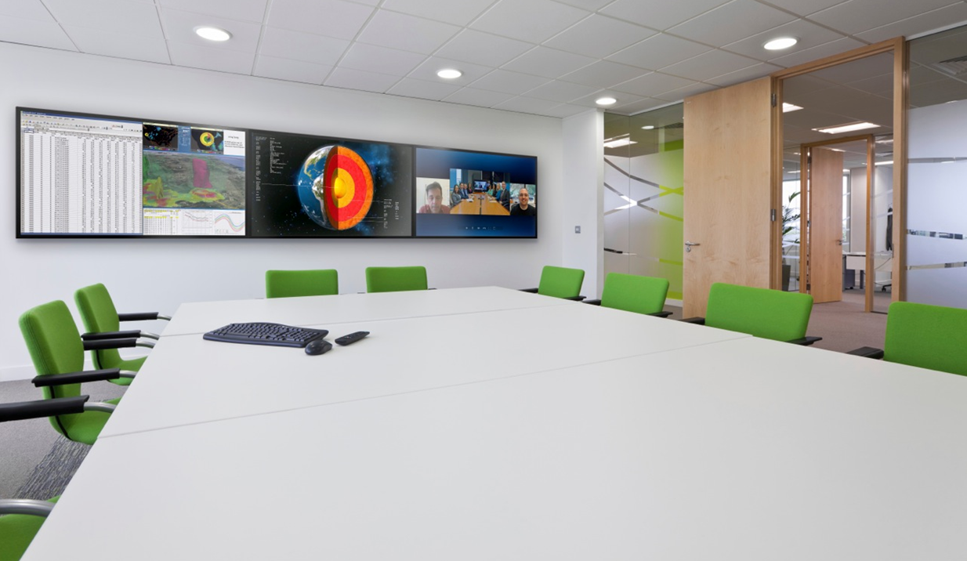
Wall Configurations
Horizontal wall configurations with Planar Profile™ tiling kit
Utilizes Planar Profile™ mounting system
Tiling Kit assists in flush side-by-side alignment
Supports range of horizontal wall sizes
Notes:
19 feet wide (3 wide)

Slide 20
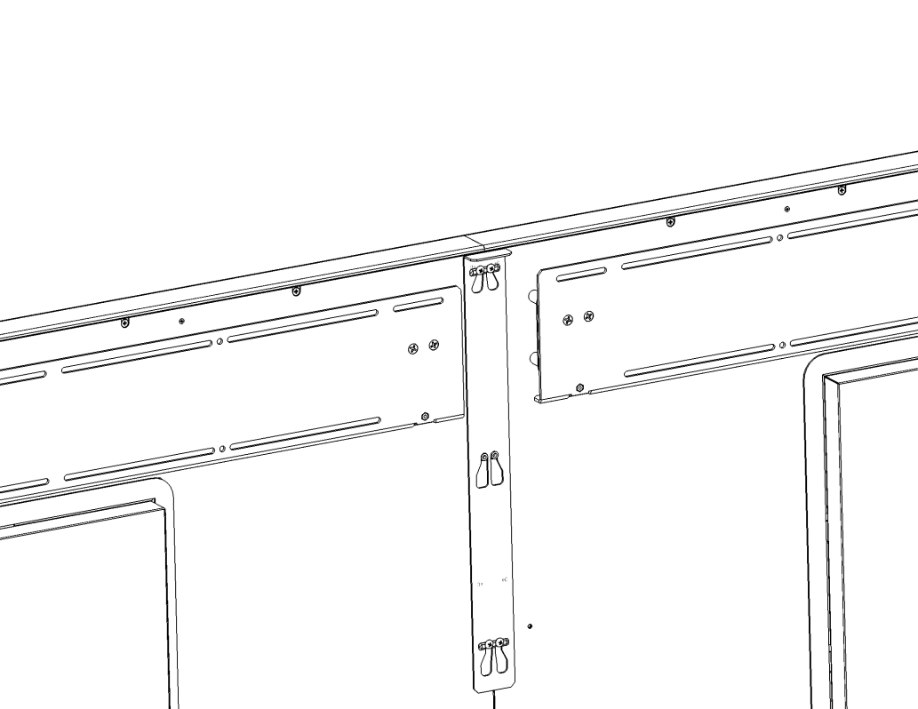
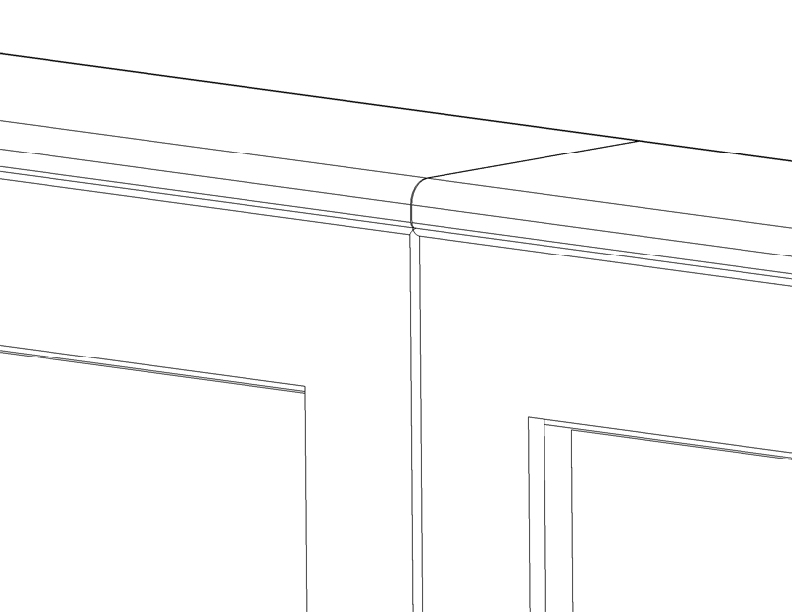
Planar Profile™ Tiling Kit
Eliminates side extrusions
Provides flush top and bottom extrusions
Template assists with mount alignment
Tiling slide tightens and aligns adjoining displays

Slide 21

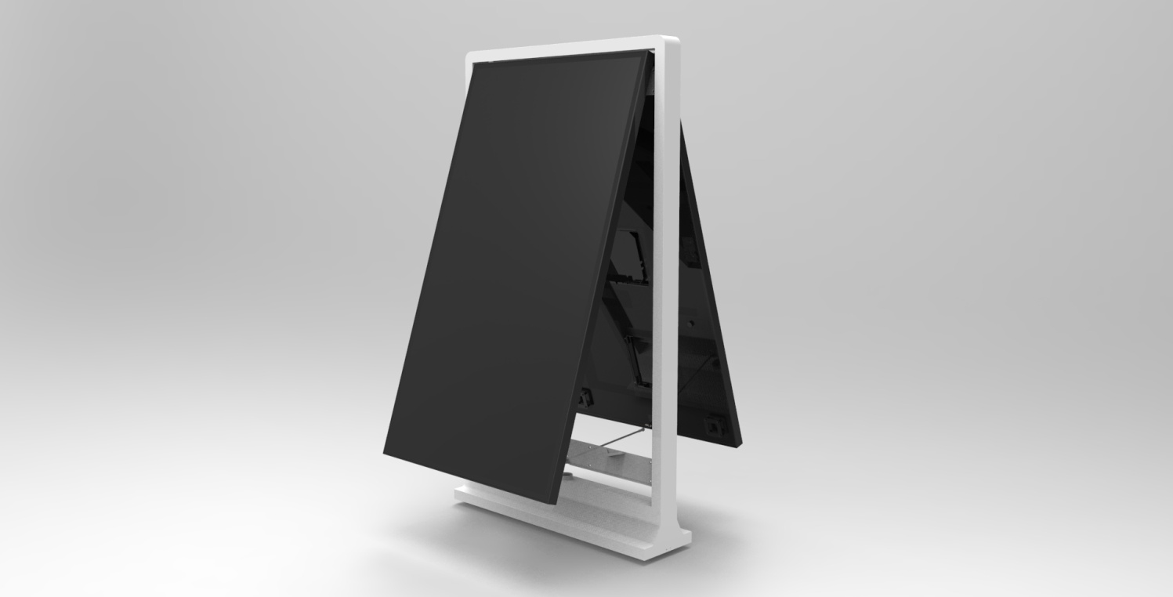
UltraRes Free-standing Pedestal
Single and double-sided
Service access mode
Supports UR8450-MX

Slide 22
Planar UltraRes™ 4K Displays
Ultra HD for Professional Applications
84” diagonal, 3840 x 2160 resolution
Outstanding image quality
Optimized for leading resolution-rich commercial applications
Advanced industrial design for function and style
Configuration options tailored to a range of commercial requirements
Advanced energy efficient architecture

Slide 23
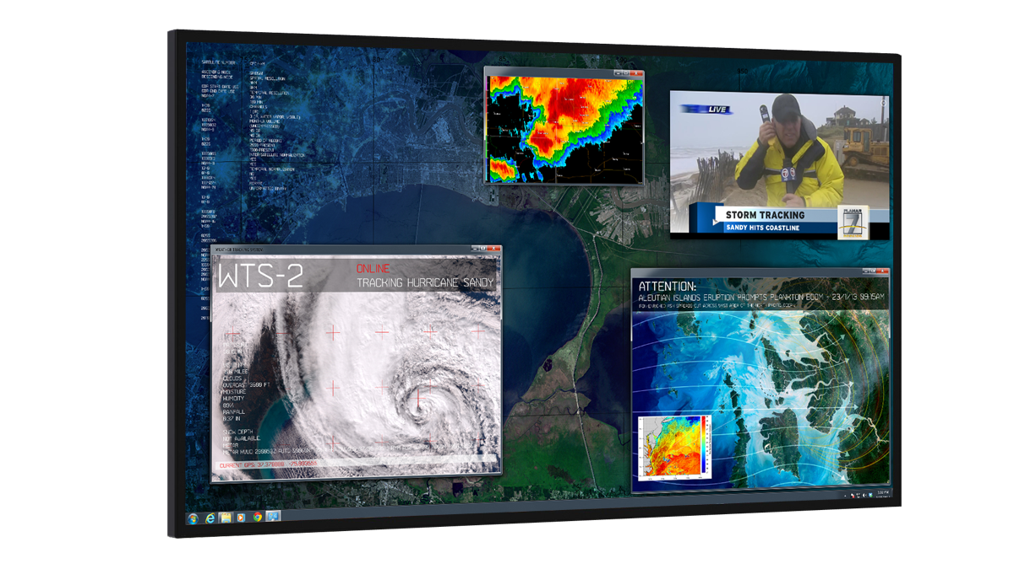
Big Display, Walks Softly
Breakthrough Large-Format Energy Efficiency
Lower power design using edge-Lit LED and passive cooling
<0.5Watt standby power usage
Auto-off signal detection
No lead or mercury
0dB noiseless operation

Slide 24
11 Reasons Professionals Need UltraRes, Not a TV
  Electronics that support professional applications.
    4K @ 60Hz.
    Multi-output graphics card support – nVidia, AMD
    Windowing processor support.
  10bit color – true end-to-end implementation
  Slimmest mounting profile and ADA compliant
  In-place service access mode (hinge and kickstand)
  Fail-over power redundancy
  0dB silent operation – Fanless
  Full serial command set, LAN and RS232, SNMP support
  Horizontal tiling kit
  Portrait orientation support (signage applications)
  3 panel options to meet specific needs
  Warranty and support

Slide 25
Thank you!

